Slide 1


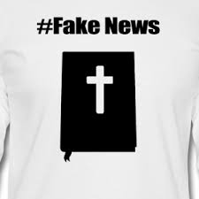

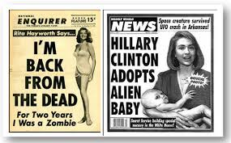
GROUP TWO PRESENTATION
Apisara
Kausiki
Tom
Xintong

Slide 2


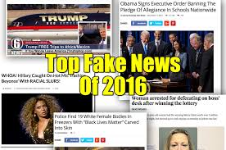
Introduction
The truth is hard- New York times
https ://www.youtube.com/watch?v=gY0Fdz350GE
There is no one definition of ‘fake news’
The visual and textual construction of fake news has an impact in its consumption.

Slide 3


Research Questions
What is the discursive constitution of ‘fake news’?
What is the relation between the construction of credibility and the consumption of ‘fake news’?

Slide 4
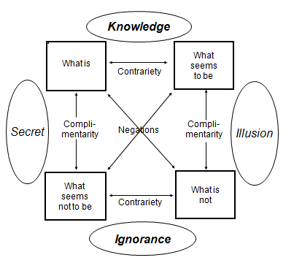
Methodology and Rationale
Relevant methodologies will be applied depending on the nature of the material collected e.g. Semiotic, Textual, Compositional or Discourse analysis.

Slide 5
Related Work: Empirical Examples
The Onion: ‘Trump claims waterboarding doesn’t come close to the excruciating torment he experiences at every moment’
An imitation show about Donald Trump and Hillary Clinton’s debate on ‘SNL’
Kellyanne Conway Blames Refugees for ‘Bowling Green Massacre’ That Never Happened.
An award-wining photograph which is suspected as a composition by photoshop.
A thirty second TV commercial named The Truth is Hard by the New York Times

Slide 6
Related Work: Literature
Reilly, I (2012) ‘Satirical Fake News and/as American Political Discourse’, The Journal of American Culture, 35:3
Khaldarova, I, Pantti, M (2016) ‘Fake News’, Journalism Practice, 10:7

Slide 7
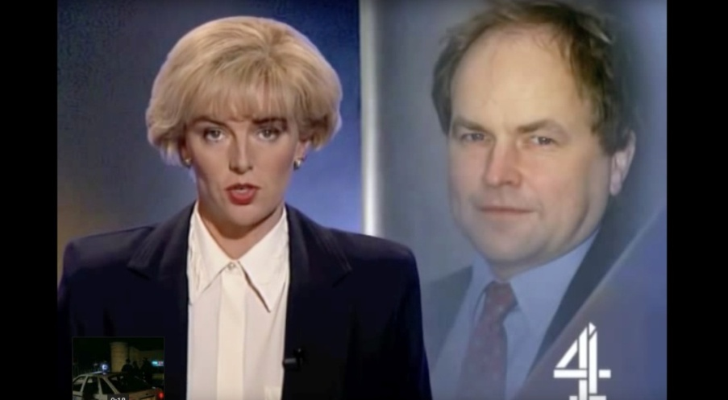
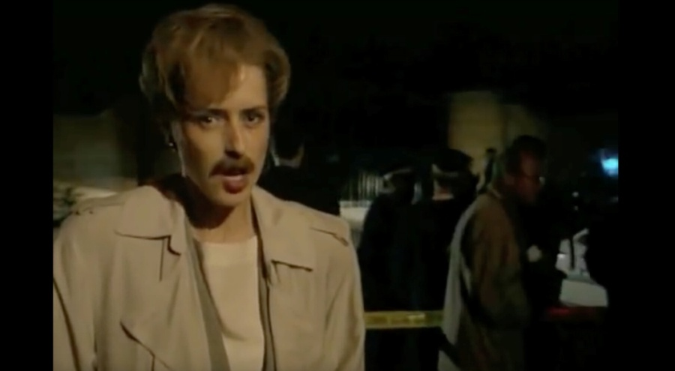
Concrete Example 1:
Clive Anderson Shot Dead
“Brasseye” - a satirical investigative documentary series, that faked a channel 4 news report about the death of Clive Anderson.
Despite the obviously satirical nature of the show, many viewers believed the story and afterwards made complaints.
A compositional analysis would look at the use of the Channel 4 News visual styles.
This illustrates an important part of our argument - “the construction of credibility.”

Slide 8
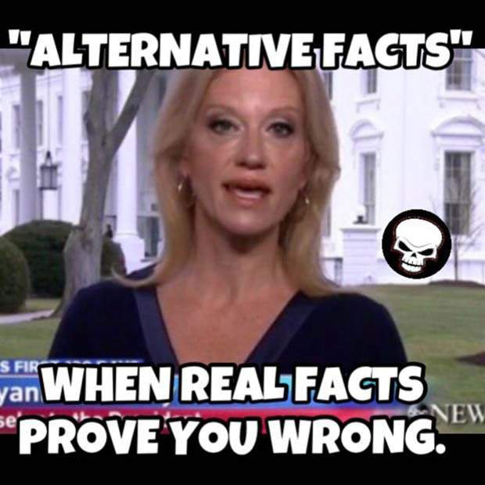
Concrete Example 2:
Kellyanne Conway & the “Bowling Green Massacre”
“Kellyanne Conway – The Bowling Green Massacre” - Discourse analysis would look at the language used in the false story.
This story is indicative of another one of the chief issues with “fake news” - a lack of fact checking.
We would propose that there is confirmation bias when looking at the spread of fake news.
This could lead to supposedly reputable sources propagating “fake news”, simply because it ties in with their own political agenda.

Slide 9


Research Planning
Activity | Month 1 |  |  |  | Month 2 |  |  |  | Month 3
Literature Review
Collect Empirical Materials
Analysis of the Empirical Materials
Writing the Research Report
Critical Reflection

Slide 10
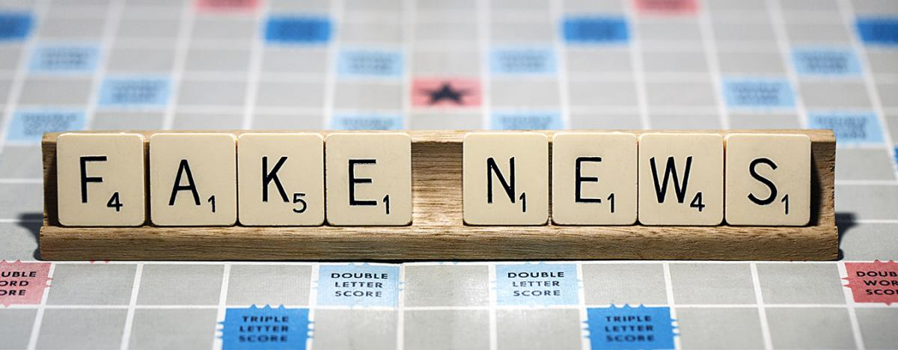
Possible Obstacles
‘Fake news’ phenomenon is still ongoing, therefore the definitions and debates are inconclusive.
Data saturation, how much to sample, when to stop?

Slide 11

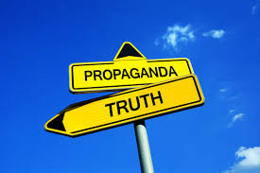
Possible Conclusions
The “construction of credibility” plays a large part in how we consume “fake news”, as it makes the legitimacy of stories hard to identify.
It places “fake news” on the “spectrum of fake-ness,” away from the easily identifiable extremes.

Slide 12
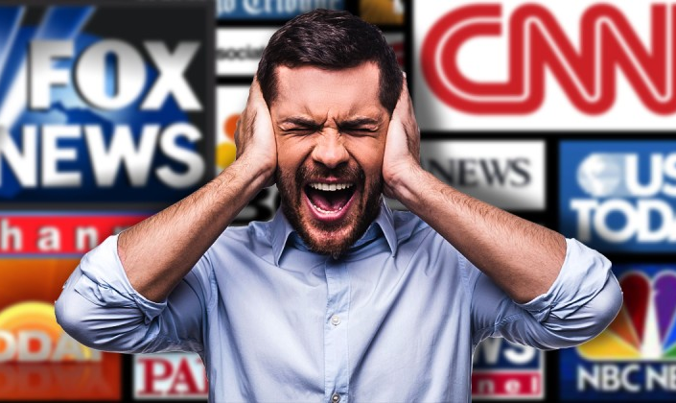
Possible Implications
Insights into the perception and consumption of ‘fake news’
Affective responses from ‘fake news’
‘Fake news’ and public discourse

Slide 13


Slide 14
Bibliography
Alternative facts (@AlternatFacts) | Twitter. (2017). [online] Twitter. Available at: https://twitter.com/alternatfacts [Accessed 17 Feb. 2017].
Anthony, S. ‘Was the 2013 World Press Photo of the Year faked with Photoshop, or merely manipulated?’ https://www.extremetech.com/extreme/155617-how-the-2013-world-press-photo-of-the-year-was-faked-with-photoshop. [Accessed: 10 February, 2017]
Biswas, Soutik.(2016) “Is Narendra Modi’s Government Unravelling?” BBC News, Available at: http://www.bbc.co.uk/news/world-asia-india-35638170. [ Accessed February 5, 2017]
Brass Eye (1997) Clive Anderson shot dead. Available at: https://www.youtube.com/watch?v=EGtdsXhXiEM [Accessed : 6 February, 2017]
Couldry, N. (2000). Inside culture. 1st ed. London: SAGE, pp.1-19.
Delancer, R. (2017). Donald Trump with senior advisers. [image] Available at: http://politicaldig.com/kellyan-and-trump-staff-using-private-email/ [Accessed 17 Feb. 2017]
‘Donald Trump And Hillary Clinton Debate On ‘SNL’ ’, http://digg.com/video/snl-debate-hillary-trump . [Accessed: 10 February, 2017]
Fast Company (2014) 74 Years of McDonald’s Marketing in Two Minutes [Video online] Available at: https://www.youtube.com/watch?v=wcawawyVzYo [Accessed March 10, 2017]
Ferro, S. ‘Was the 2013 World Press Photo Of The Year A Fake?’, http://www.popsci.com/technology/article/2013-05/was-2013-world-press-photo-year-fake [Accessed: 10 February, 2017]
‘Gaza Burial’, https://www.worldpressphoto.org/collection/photo/2013/spot-news/paul-hansen. [Accessed: 10 February, 2017]

Slide 15
Bibliography cont.
Reilly, I (2012) ‘Satirical Fake News and/as American Political Discourse’, The Journal of American Culture, 35:3
Gregg, M., Seigworth, G. (2010). The Affect Theory Reader. 1st ed. Durham, NC: Duke University Press
InfoWars, (2017). CNN Resurrects ‘Fake News’ Dossier Without Proving Trump Connection » Alex Jones’ Infowars: There’s a war on for your mind!. [image] Available at: http://www.infowars.com/cnn-resurrects-fake-news-dossier-without-proving-trump-connection/ [Accessed: 17 February, 2017]
Iovine, A. (2017). Press Secretary Sean Spicer responds to mocking satire about himself – AOL News. [online] Aol.com. Available at: https://www.aol.com/article/news/2017/01/30/press-secretary-sean-spicer-responds-to-mocking-satire-about-him/21703183/ [Accessed: 2 February, 2017].
Khaldarova, I, Pantti, M (2016) ‘Fake News’, Journalism Practice, 10:7
‘Kellyanne Conway Says Her Bowling Green Interview Won Praise — before the “haters”’ Washington Post. Available at: https://www.washingtonpost.com/news/the-fix/wp/2017/02/04/i-misspoke-one-word-kellyanne-conway-calls-her-critics-haters-after-bowling-green-fiasco/.[ Accessed:5 February, 2017]
Morra, J., Smith, M. (2006) Visual Culture: Critical Concepts in Media and Cultural Studies, London: Routledge.
Mukherjee, S.(2016) ‘JNU Row: Fake, Doctored Video of Kanhaiya Kumar Raising Slogans Exposed’ [Video online] Available at: http://www.india.com/news/india/jnu-row-fake-doctored-video-of-kanhaiya-kumar-raising-slogans-exposed-video-964775/.[ Accessed: 5 February, 2017]
Newcomb, A. (2017). How’s Google Doing In Its Fight Against Fake News? – NBC News. [online] NBC News. Available at: http://www.nbcnews.com/tech/tech-news/how-s-google-doing-its-fight-against-fake-news-n712551 [Accessed 27 Jan. 2017]
Phipps, C. ‘Kellyanne Conway Blames Refugees for ‘Bowling Green Massacre’ That Never Happened.” The Guardian, Available at: https://www.theguardian.com/us-news/2017/feb/03/kellyanne-conway-refugees-bowling-green-massacre-never-happened. [Accessed: February 3, 2017]

Slide 16
Bibliography cont.
Rose, G. (2012). The Question of Method: Practice, Reflexivity and Critique In Visual Culture Studies. In: Heywood, Ian and Sandywell, Barry eds. The Handbook of Visual Culture. London: Berg, pp. 542–558.
Rose, G. (2007). Visual Methodologies ; an introduction to the interpretation of visual materials. 1st ed. London, U.K.: SAGE, pp.191-226.
‘SHOTCHA OSCAR; Prankster Noel’s Fury at Sick TV Murder Stunt. – Free Online Library.’ Available at: https://www.thefreelibrary.com/SHOTCHA+OSCAR%3B+Prankster+Noel’s+fury+at+sick+TV+murder+stunt.-a061130608 [Accessed: 6 February, 2017]
Spradley, J (1979). The Ethnographic Interview. Boston: Wadsworth. 34.
The Huffington Post (2017). Germany Weighs Stiff Fines for Social Media Sites That Carry Fake News | The Huffington Post. [image] Available at: http://www.huffingtonpost.com/entry/german-fake-news-fines_us_585843d5e4b03904470a1dfb [Accessed: 2 February, 2017]
The Onion, (2017). Trump Claims Waterboarding Doesn’t Come Close To The Excruciating Torment He Experiences At Every Moment. [online] The Onion. Available at: http://www.theonion.com/article/trump-claims-waterboarding-doesnt-come-close-excru-55158 [Accessed: 27 January, 2017]
The New York Times (2017). The Truth is Hard. [Video online] Available at: https://www.youtube.com/watch?v=gY0Fdz350GE. [Accessed: 3rd March, 2017]
‘Traditional and Digital Manipulation in Documentary Photography’, https://www.pinterest.com/Rosedesiano/traditional-and-digital-manipulation-in-documentar/. [Accessed: 10 February, 2017]
Tyler, I. (2008). ‘Chav Mum Chav Scum’. Feminist Media Studies, 8(1), pp.17-34.
Wikipedia: the Free Encyclopedia. (2017). Fake news website – Wikipedia. [online] Available at: https://en.wikipedia.org/wiki/Fake_news_website [Accessed: 27 January, 2017]

